Slide 1
Medical Imaging Segmentation
Ian Jenkins
ipj2103@columbia.edu
COMS4995
https://github.com/ipj2103/COMS4995_final_project

Slide 2
In This Presentation
Dealing with the data
Attempt at true semantic segmentation
Shift to sub slide classification
Results
Experiments
Final code walkthrough

Slide 3
Dealing with the Data

Slide 4
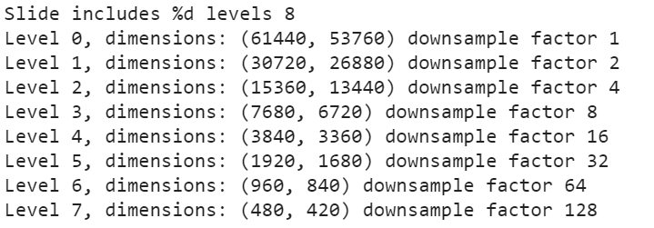
Data Challenges
Inherent class imbalance
Limited subset of the full Camelyon16 dataset (20 slides)
Highest magnification levels (level 0 & 1) can be too large to load into RAM
Can crash non Colab Pro environments ☺
Tif files are large even when storing them on disk
Nearly fills up non Colab Pro environments

Slide 5
Splitting data for training, validation, and testing
17 slides used for training/validation; 3 slides used for test
Testing data is left as whole slides
Train and val data are saved as fixed size (e.g. 299 x 299) sub image datasets
Split datasets by level; each model is only trained at one mag level
Wanted roughly even splitting between normal and cancerous examples
First add every cancerous example from each slide
Next determine how many `N` non cancerous samples are needed per slide to have unbalanced classes in the training and validation data
Randomly sample regions of each slide (still at the current zoom level) until `N` have been added
Add them to the negative set if there are no positives in the mask and there is > 25% flesh value in the sub image (using starter code util)

Slide 6
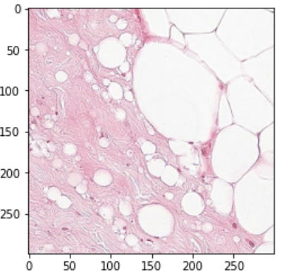
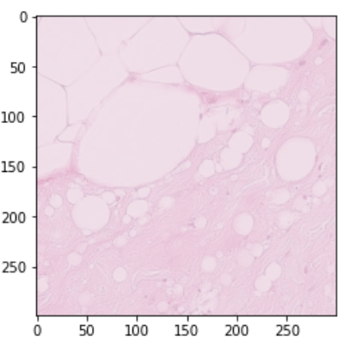
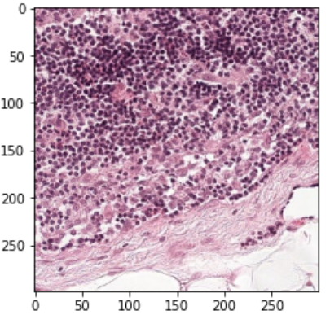
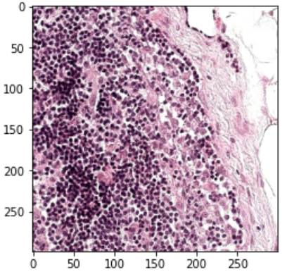
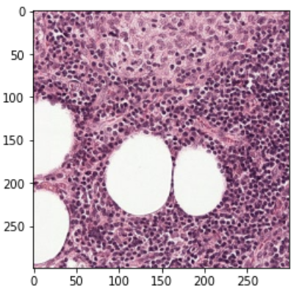
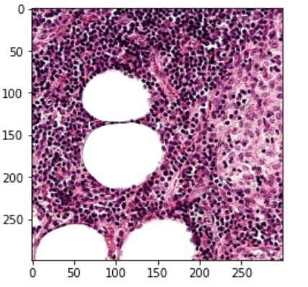
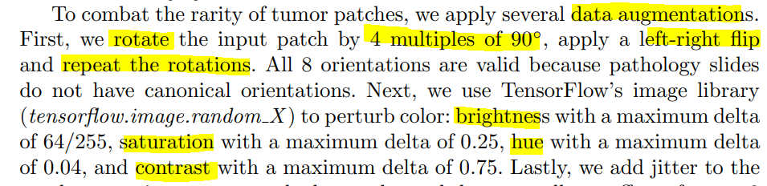
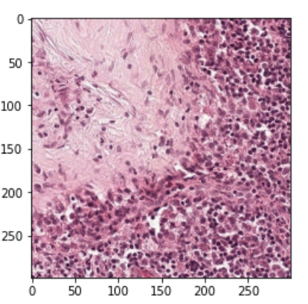
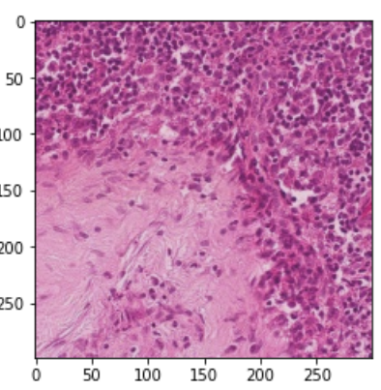
Data augmentations
Attempted to follow the augmentations of the paper fairly closely
Right: Original and augmented training examples
Below: excerpt from Detecting Cancer Metastases on Gigapixel Pathology Images

Slide 7
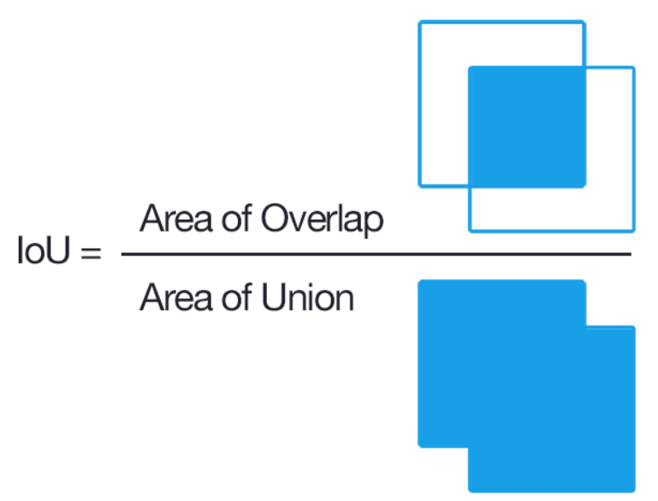
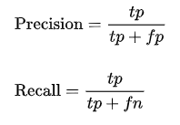
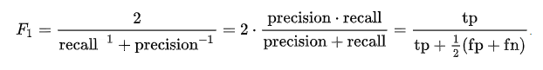
Defining Success Metrics
To quantify overall accuracy for predicting heat maps and masks, the following are what based prediction success on at the slide level:

Slide 8
Attempt at Semantic Segmentation

Slide 9
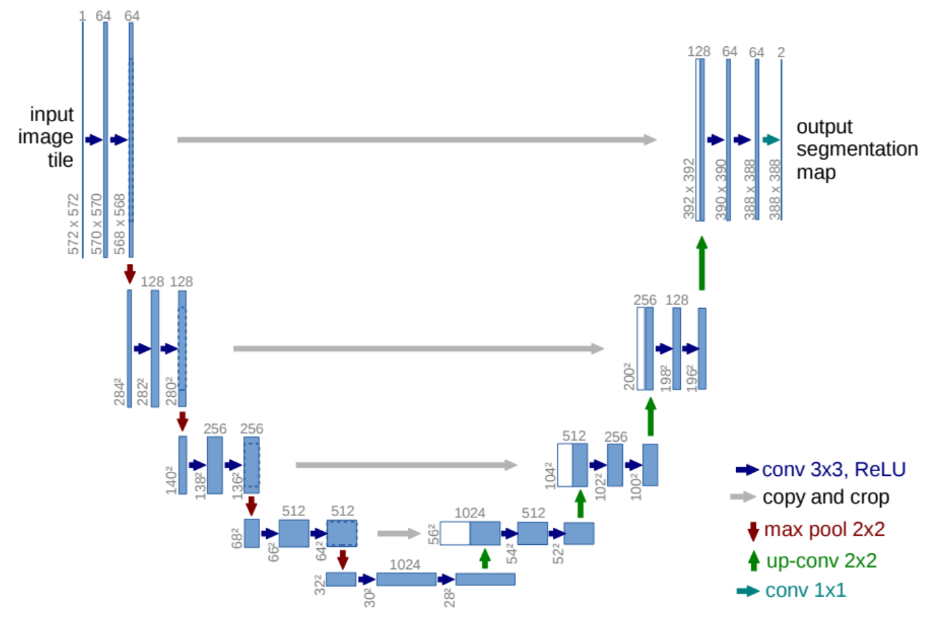
Semantic Segmentation Attempt – Unet
Try to incorporate information about both “what” and “where” to localize tumors → Unet
Has been used for similar tasks (https://arxiv.org/abs/1505.04597)
Would output a tensor that is the same shape as the input but with channels for the confidence of each class → argmax to find the output mask
Similar to classifying each pixel

Slide 10
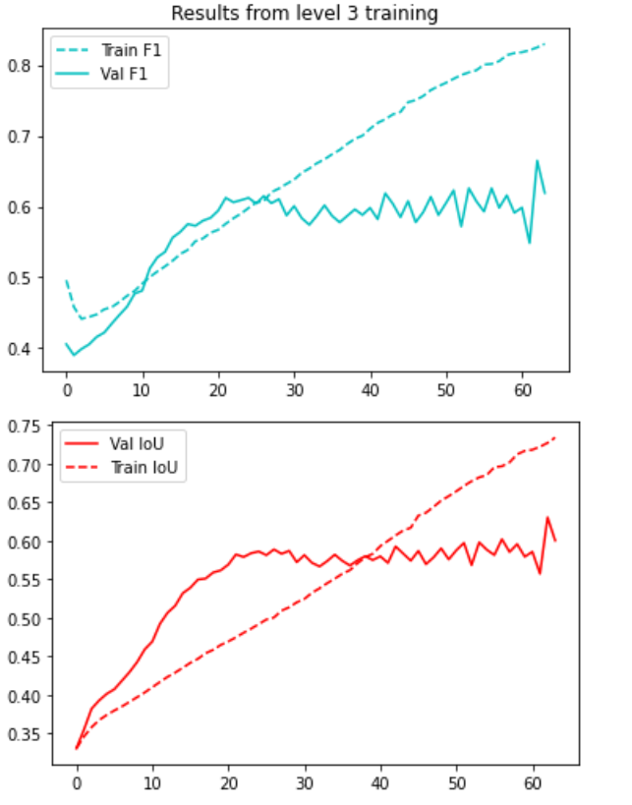
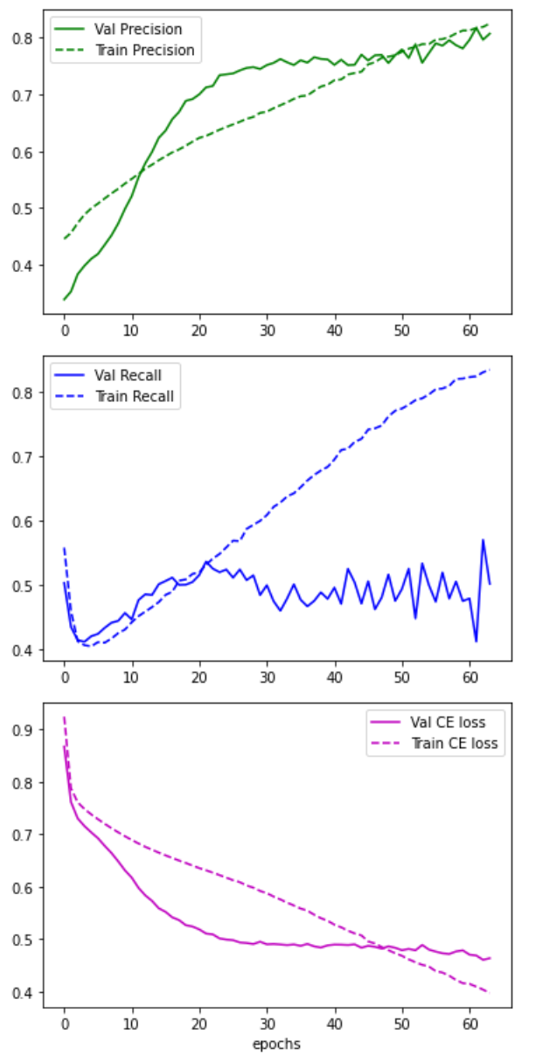
Attempt at Level 3 Training on Unet

Slide 11
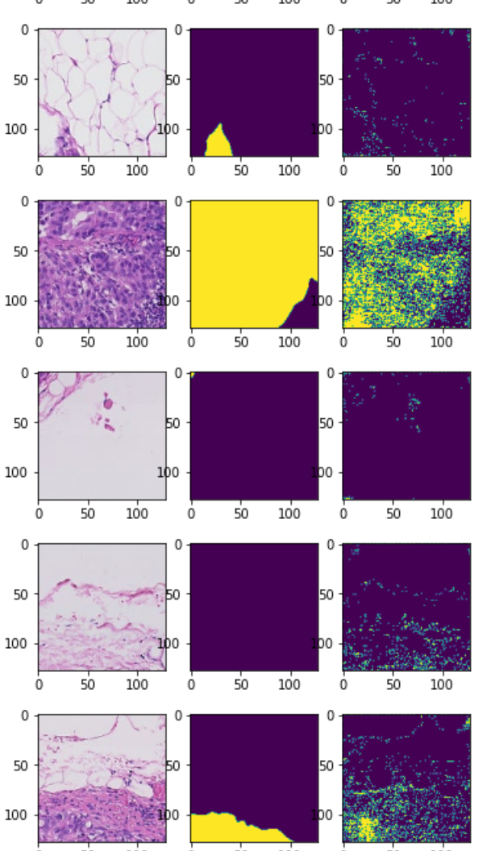
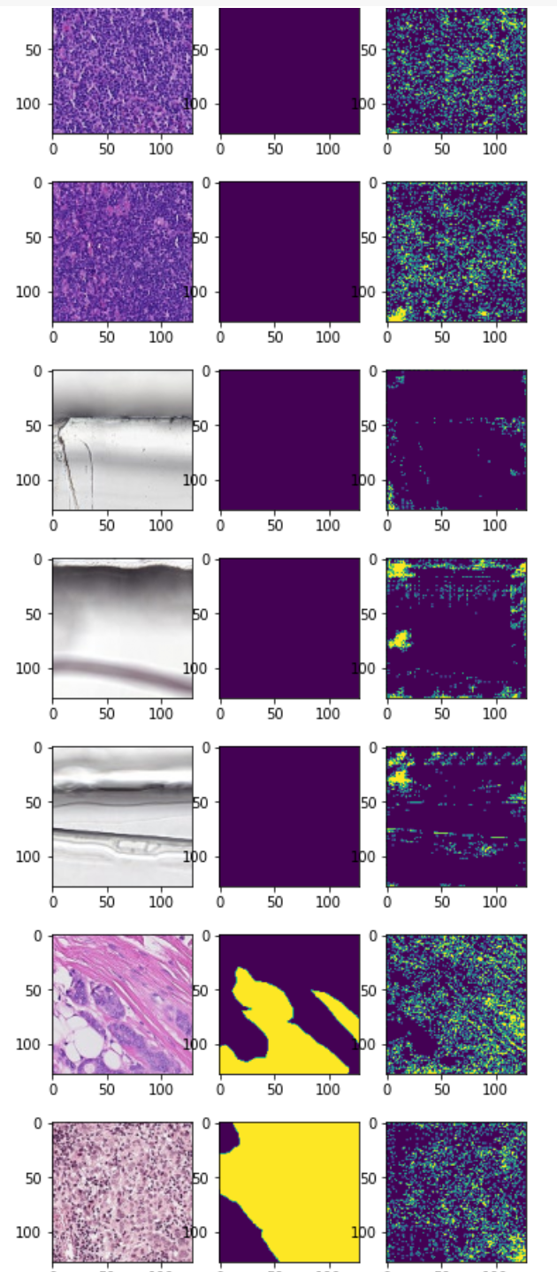
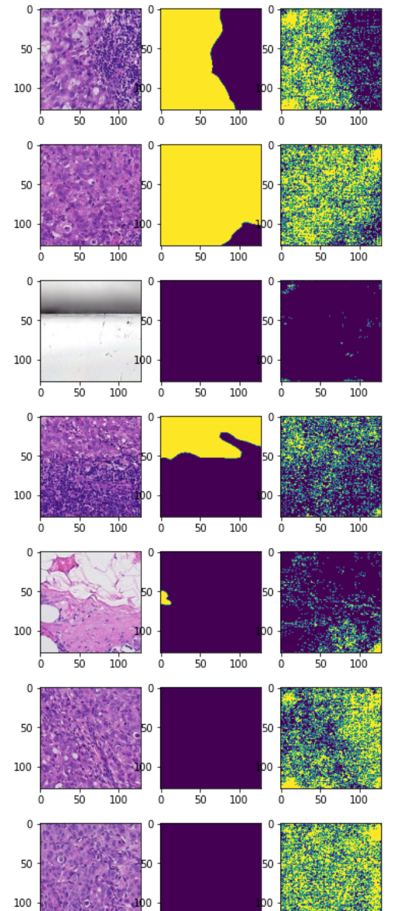
Level 3 Training Attempt Results

Slide 12
Semantic Segmentation Challenges
Low convergence speed
Needed to train for many epochs at a very low learning rate
Low inference speed; High spatial cost
Would need to upsample low mag images to a base higher resolution
Otherwise there’s potential to lose fine grained output features downsampling by up to a factor of ~128
Low amount of data for size of network
Easily overfitting
Attempted different Unet sizes with little success
Seemingly unstable precision and recall

Slide 13
Shift to Classification

Slide 14
Classification Attempt – Simple CNN
Can replicate the effect of true semantic segmentation by classifying relatively small sub regions of the large slide image
Now we only really care about the “what” rather than the “where”
Use less parameters to only down sample the image to a smaller representation, flatten, and predict a confidence that the image contains cancer with a Dense(1) layer
Fewer parameters means faster convergence times and less overfitting
To predict at different zoom levels → only have to downsample a constant value
Possible to use a very low resolution image as the base

Slide 15
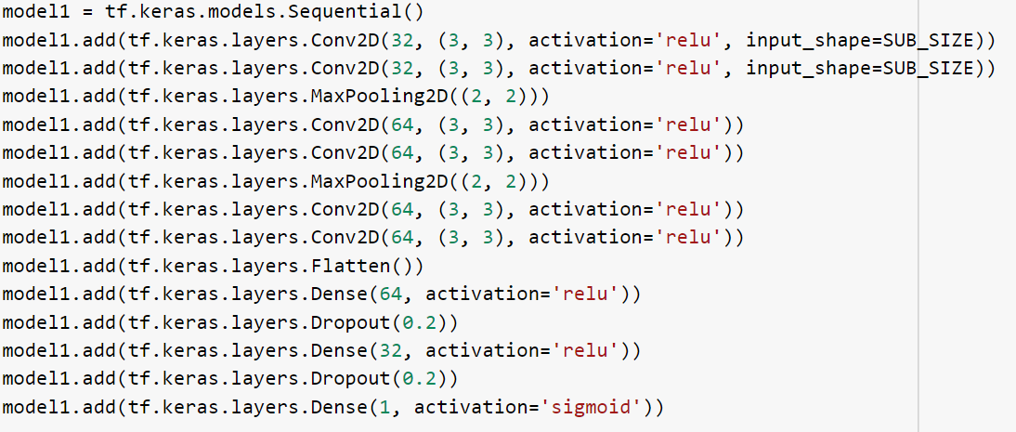
Single Zoom Level CNN Architecture
Each CNN is identical, but trained at a single zoom level

Slide 16
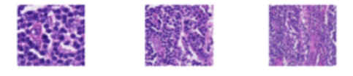
Multi-Model Architecture
Average resized prediction regions
Similar to approach by Liu et al (https://arxiv.org/abs/1703.02442), but just averaging confidences here
Broadcast scalar confidence predictions to an ndarray with a shape set by the lowest magnification level
CNN1
CNN2
CNN3
Empty low magnification region just to set the shape of the output
(1,299,299,3)
(1,299,299,3)
(1,299,299,3)
Level 1
Level 2
Level 3

Slide 17
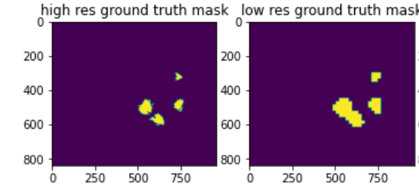
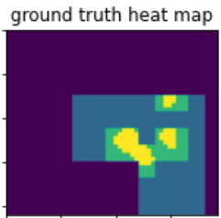
New Definitions Regarding Classification Model
Definitions:
High res ground truth mask → Binary mask that comes as a label with the data
Low res ground truth mask → Perfect possible prediction at highest mag level
Ground truth heat map → Perfect possible heat map from all used mag levels

Slide 18
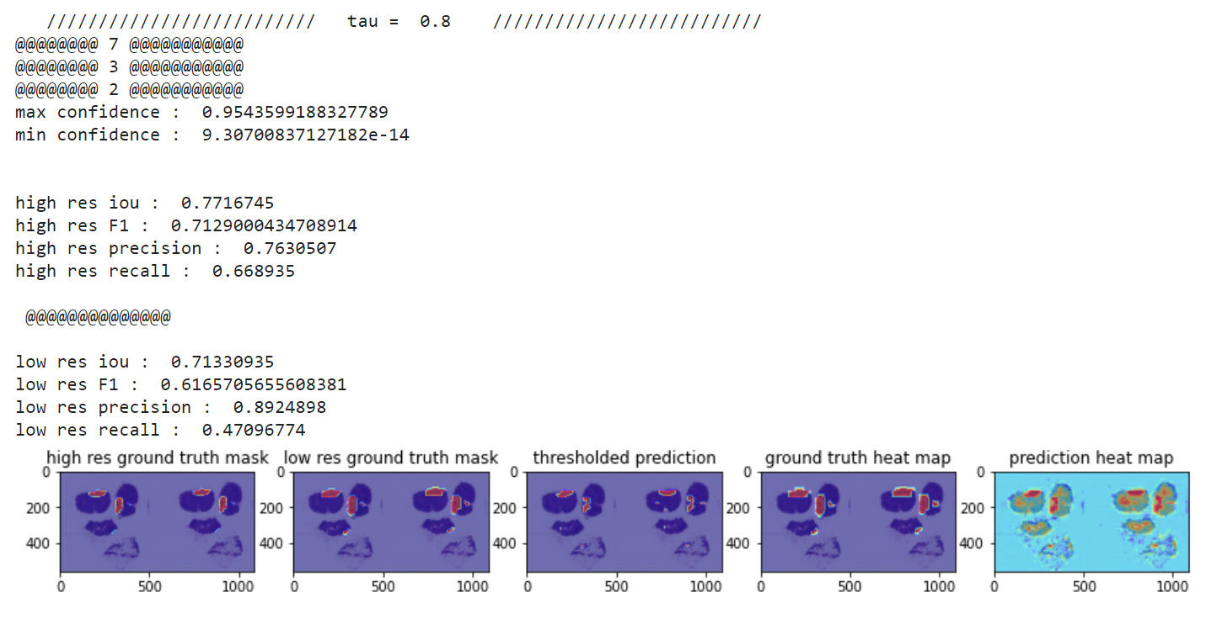
Classification Metrics of Success
Still useful to use things like IoU, Precision, Recall, and F1 on the output heatmap
Decided to threshold the multi-model output at some confidence to obtain a binary mask
Then can caluculate IoU, F1, etc. against both the high and low res ground truth binary masks

Slide 19
Results

Slide 20
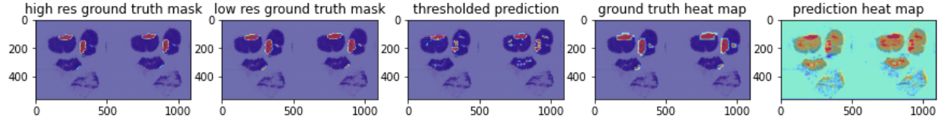
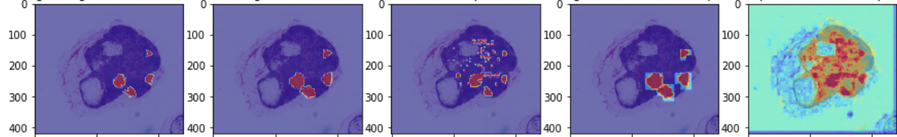
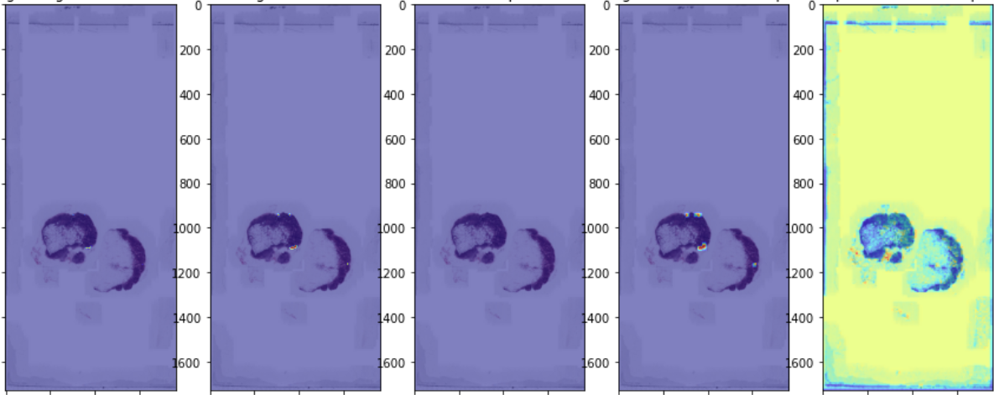
Level 1, 2, 3 Predictions on Holdout Test Slides

Slide 21
Success Metrics on test set
Average High res IoU: 0.645 (0.718 excluding the third example)
Average High res F1: 0.413 (0.619 excluding the third example)
Average precision: 0.377 (0.566 excluding the third example)
Average recall: 0.478 (0.717 excluding the third example)
Average Low res IoU: 0.630 (0.695 excluding the third example)
Average Low res F1: 0.387 (0.580 excluding the third example)
Average precision: 0.422 (0.634 excluding the third example)
Average recall: 0.364 (0.546 excluding the third example)
Conclusion: This multi-model classification architecture does a reasonable job of localizing cancerous regions on complete, unseen slide data

Slide 22
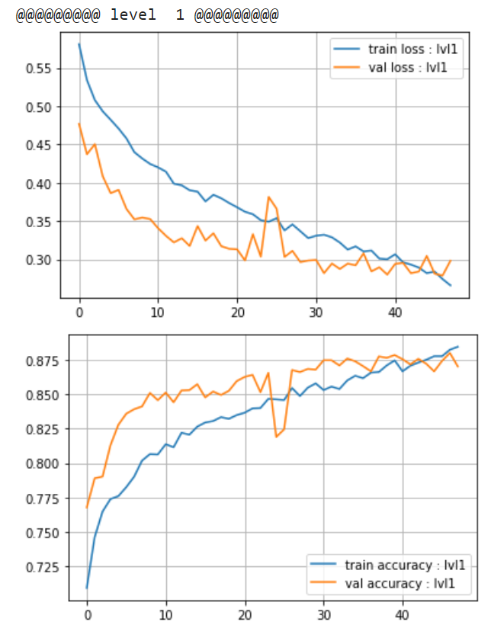
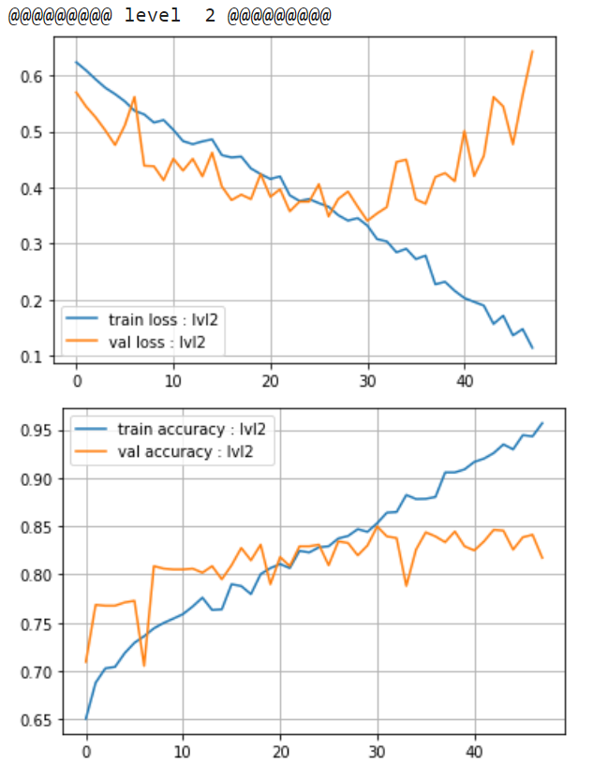
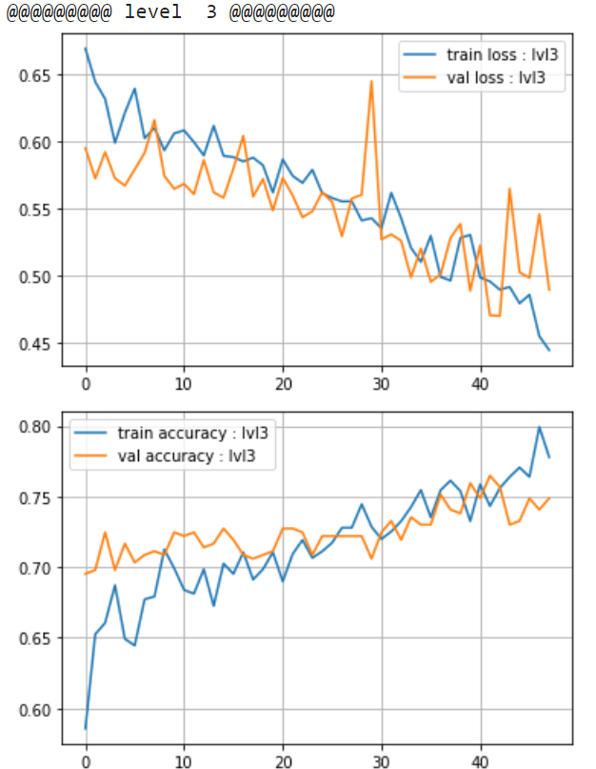
Training curves for saved weights
LR = 1e-5
LR = 5e-5
LR = 1e-4
44
28
48
22

Slide 23
Experiments

Slide 24
Experiments
Different learning rates at different zoom levels
Different intensities of augmentations
Different tif files in test vs train/validation → try to mimic the distributions
Tried to fix over and under predicting (better balance of precision and recall)
Dataset forming methods
Sliding window until no mask and > 25% flesh passes the threshold
Randomly sample an even number of normal images each slide (with flesh constraints)
Wanted to try:
Splitting train/val and test slides analytically
Different samplings of the normal examples
Use a poor cancer segmentation model to search for flesh

Slide 25
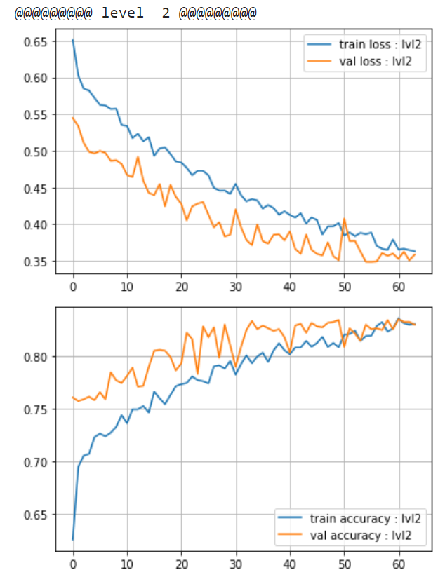
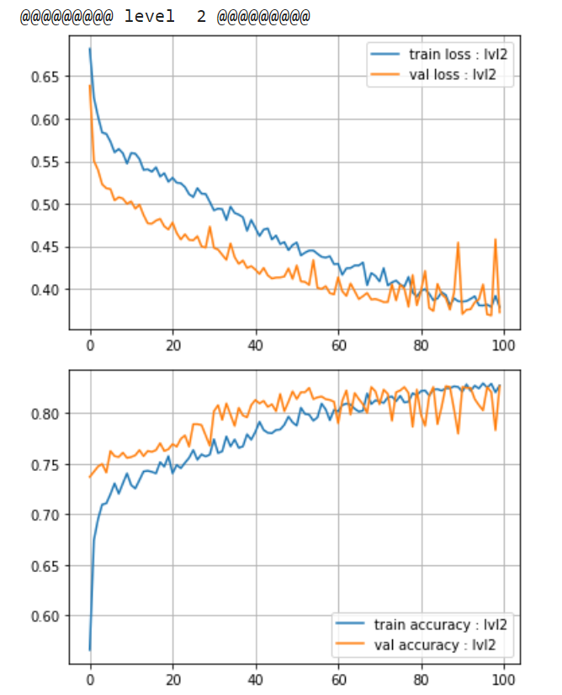
Level 2 Learning Rates
LR = 5e-5, 16 batch, 48 epoch
LR = 1e-5, 16 batch, 64 epoch
LR = 5e-6, 16 batch, 100 epoch

Slide 26
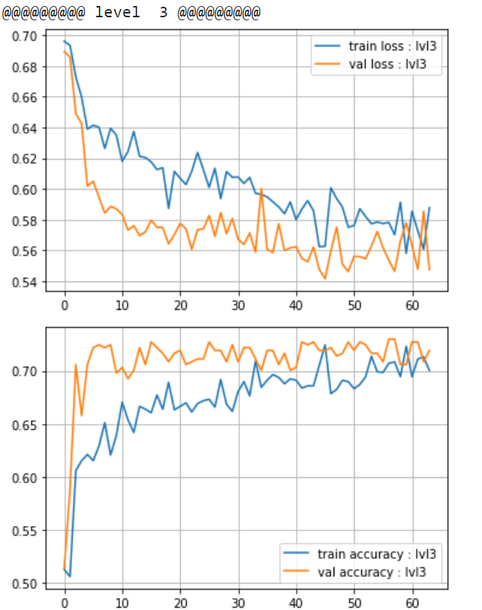
Level 3 Learning Rates
LR = 5e-5, 16 batch, 48 epoch
LR = 1e-5, 16 batch, 64 epoch
*Ended up raising to 1e-4 for training the final model

Slide 27
Code Walkthrough

Slide 28
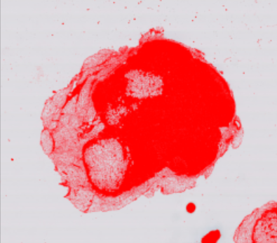
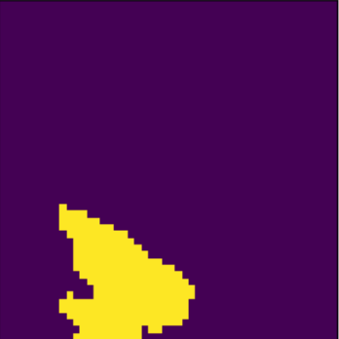
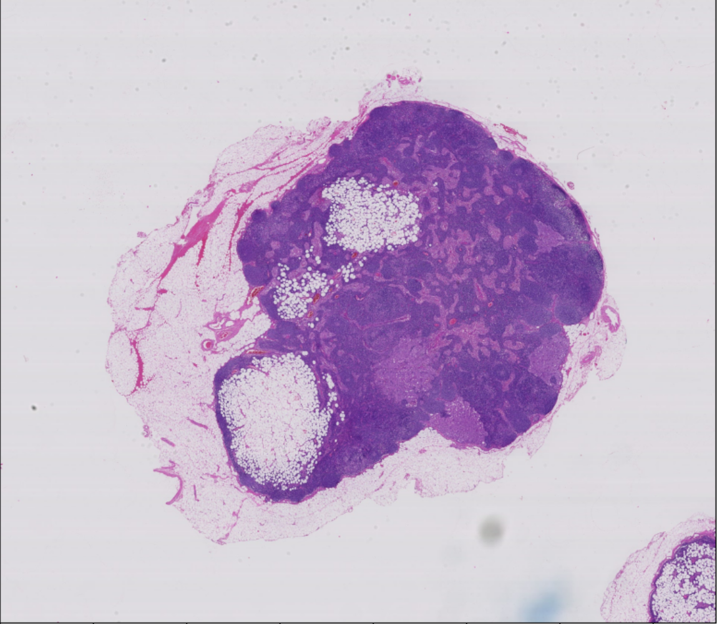

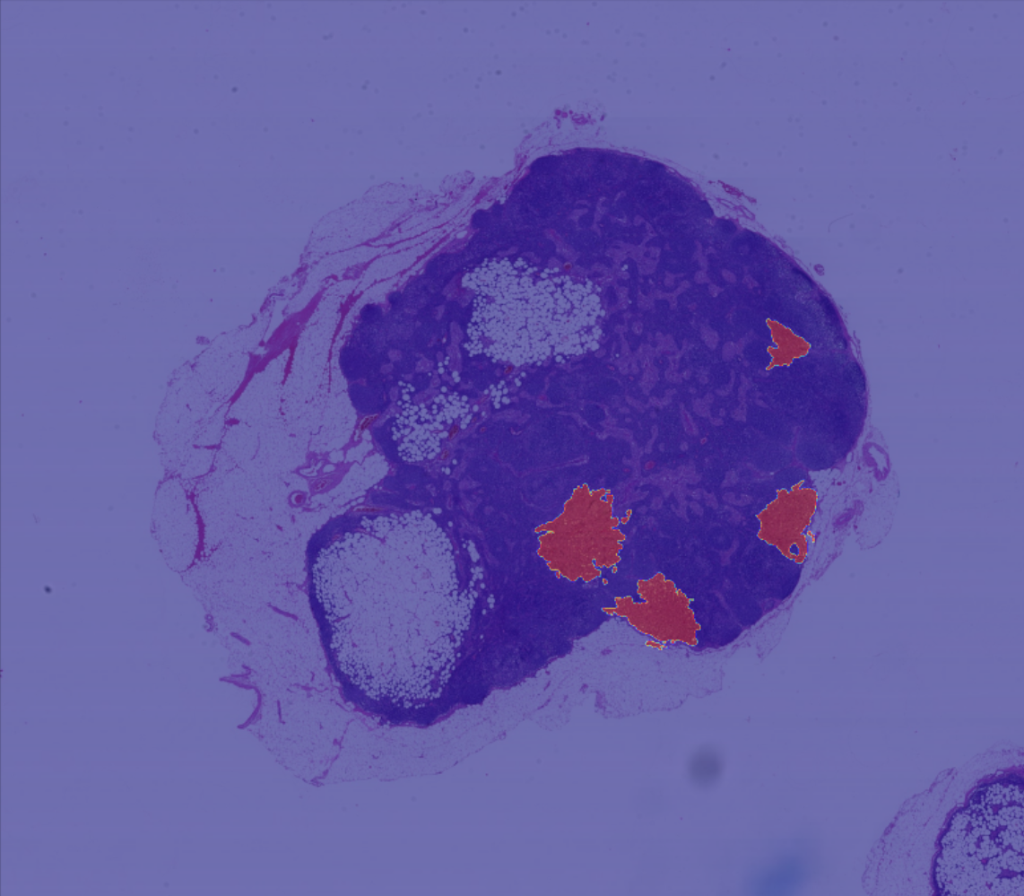

Slide 29
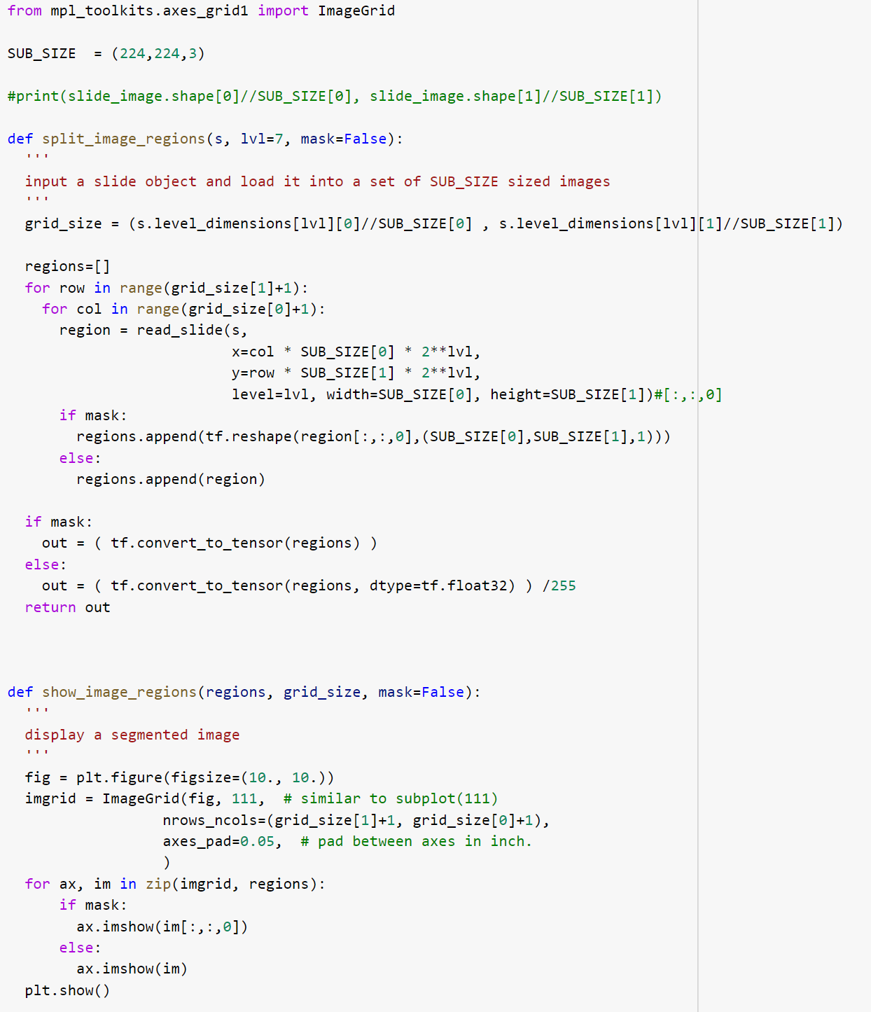

Slide 30
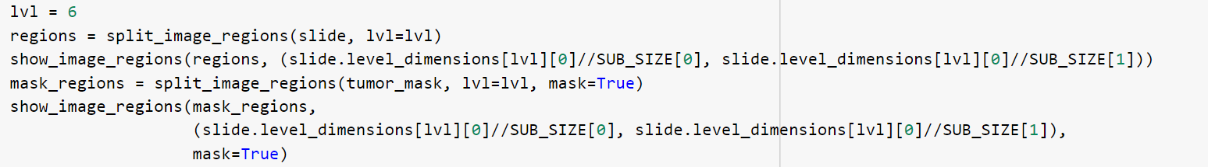
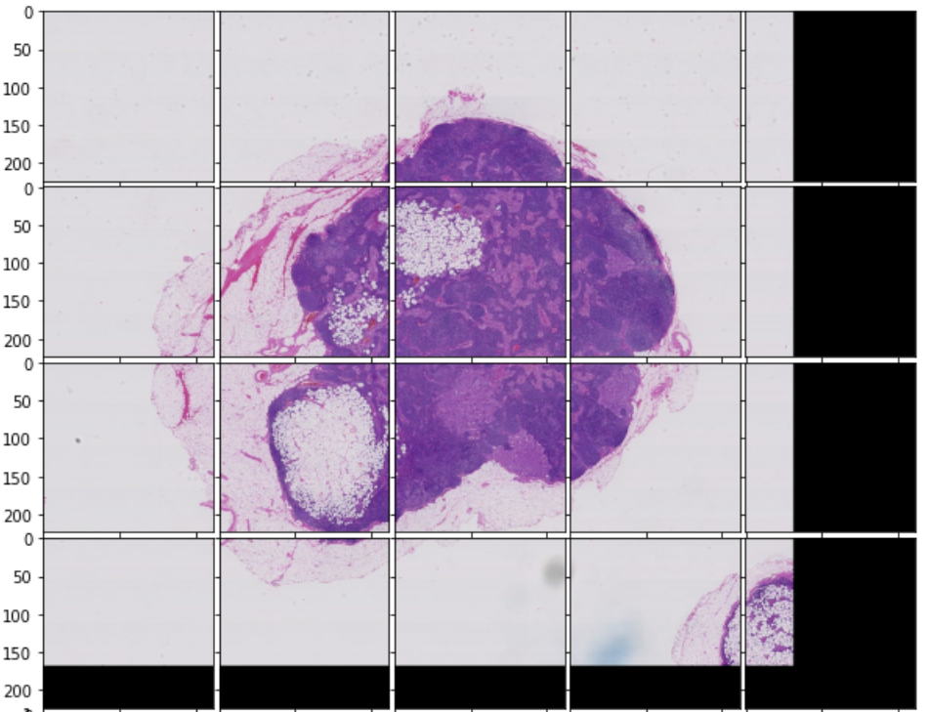
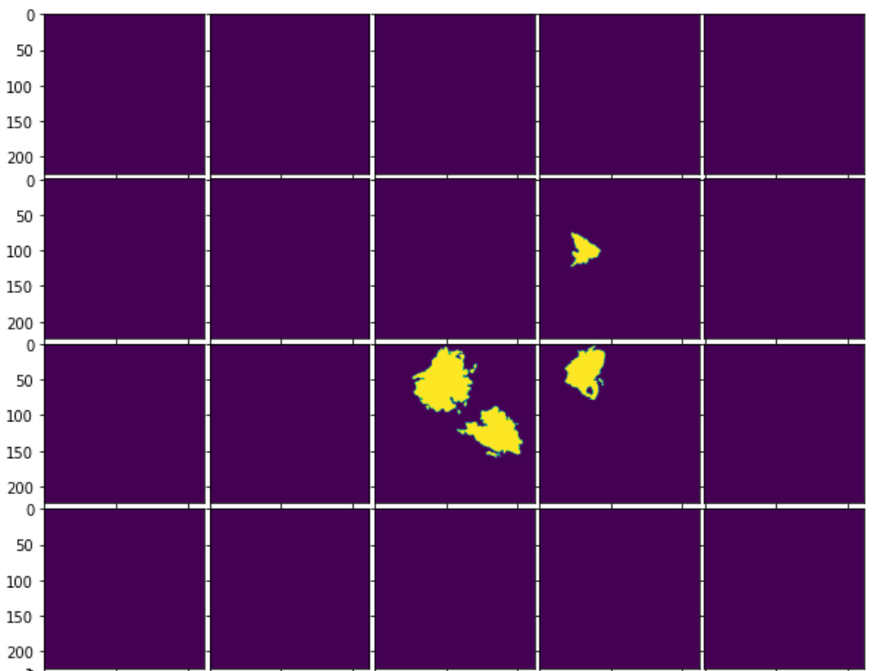
*These are essentially what is used to search for images to be used in training and validation sets

Slide 31
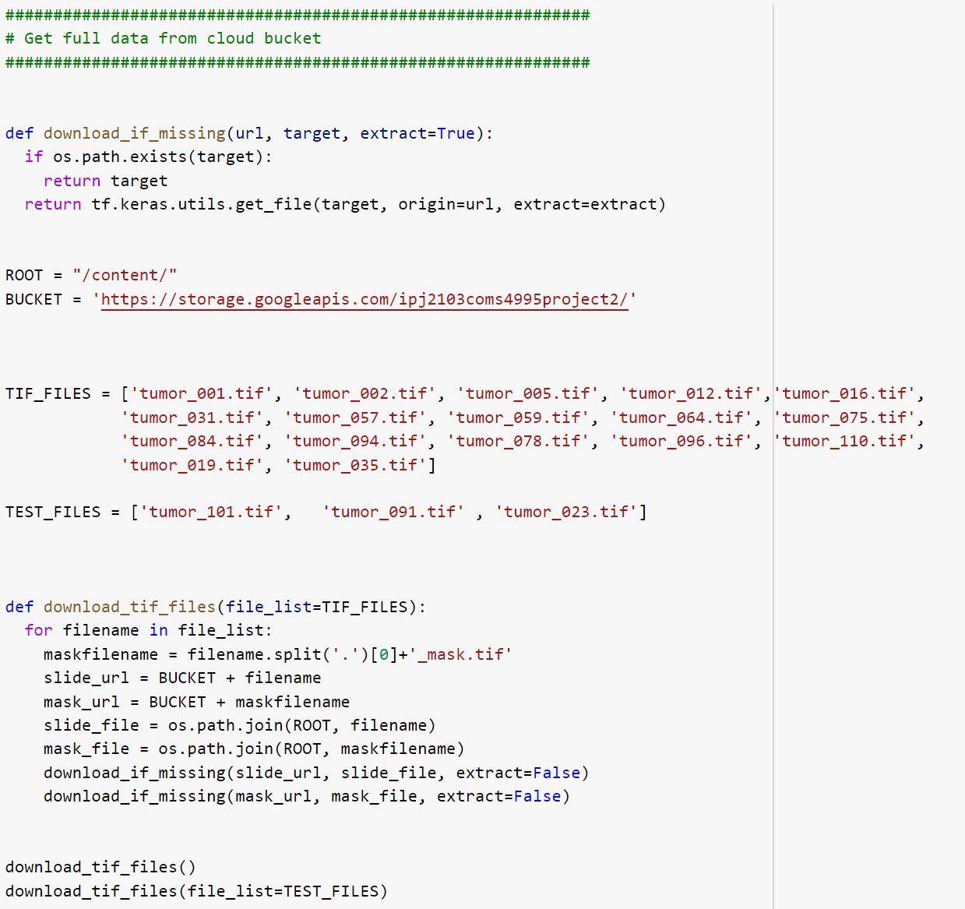
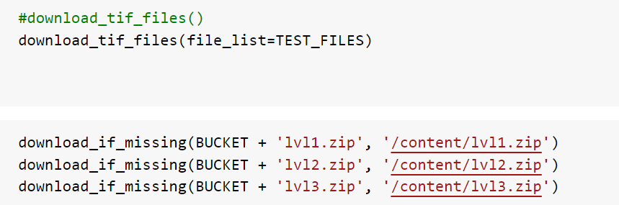
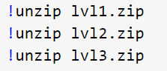

Slide 32
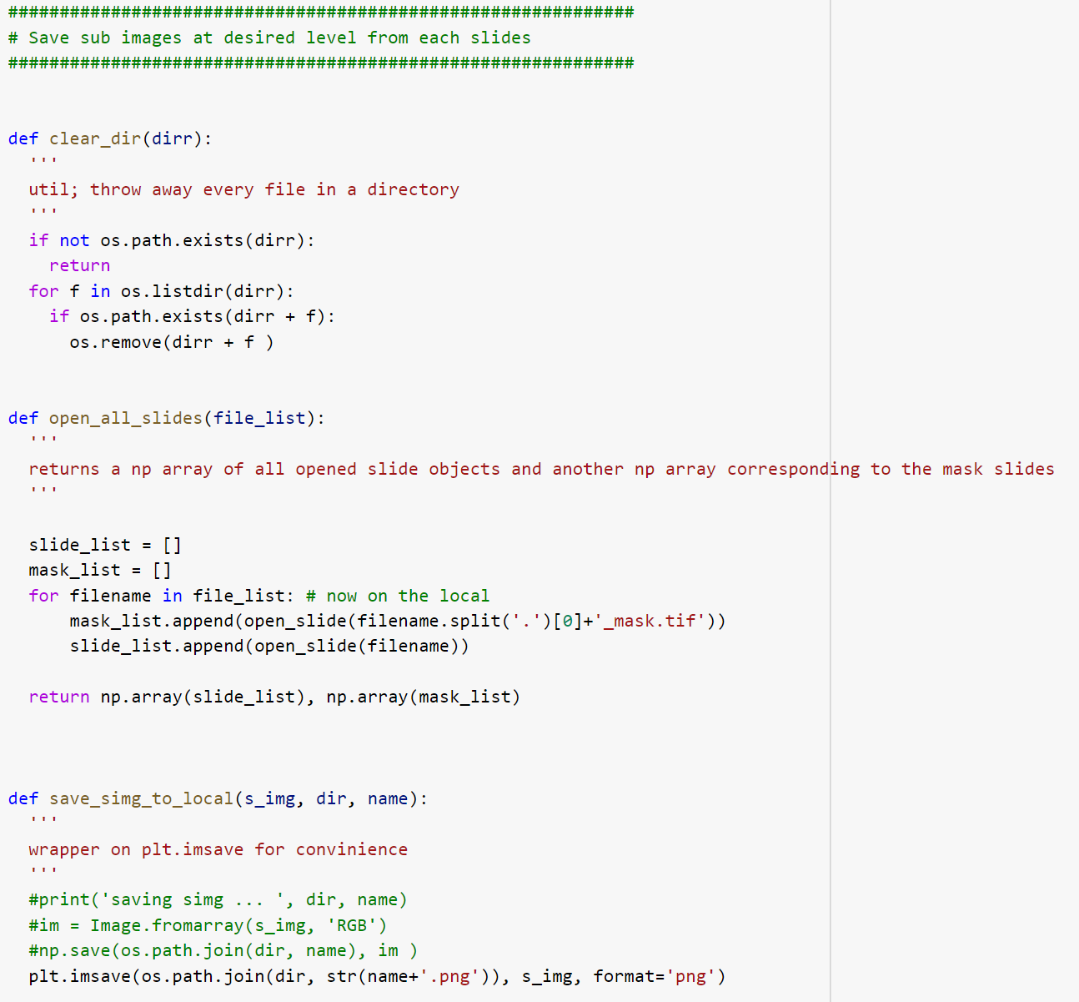

Slide 33
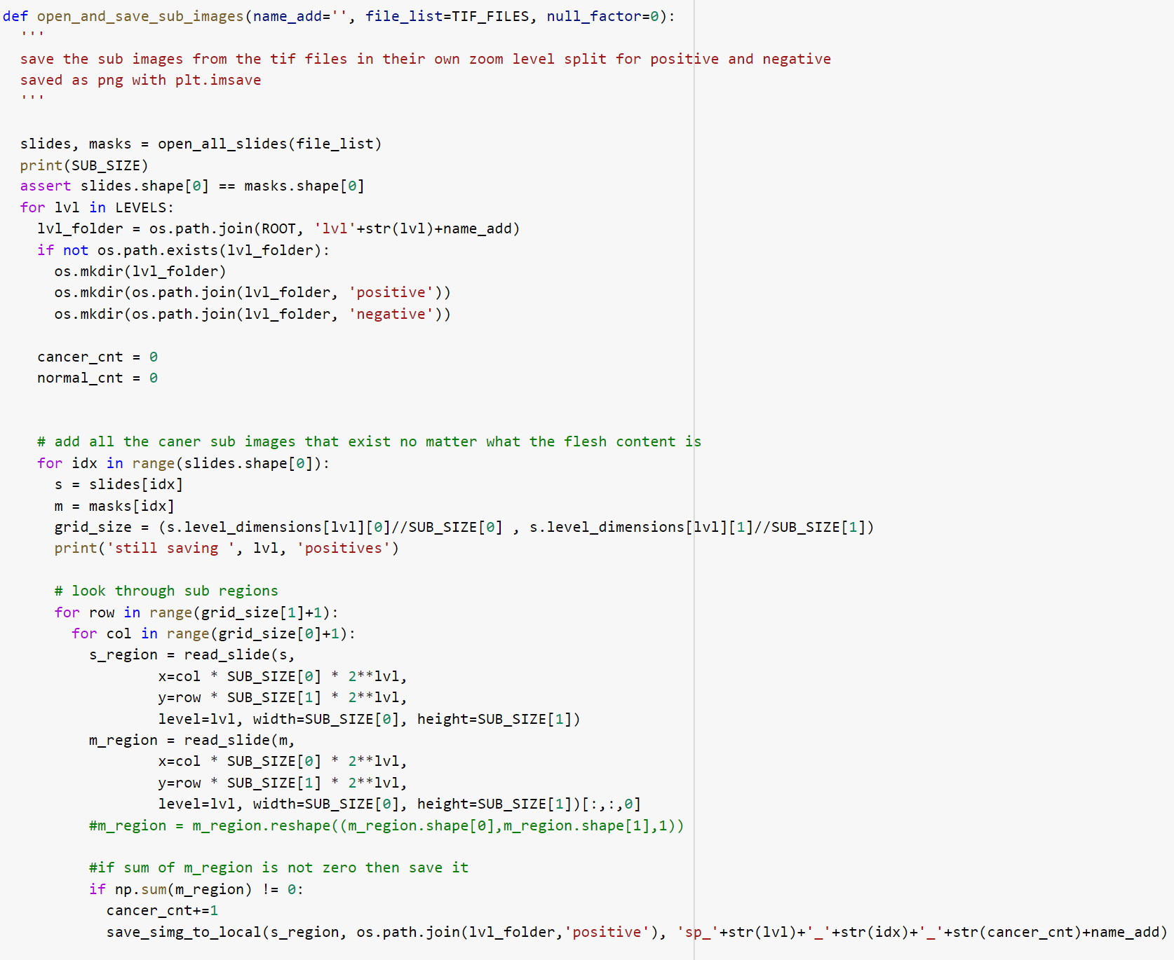

Slide 34
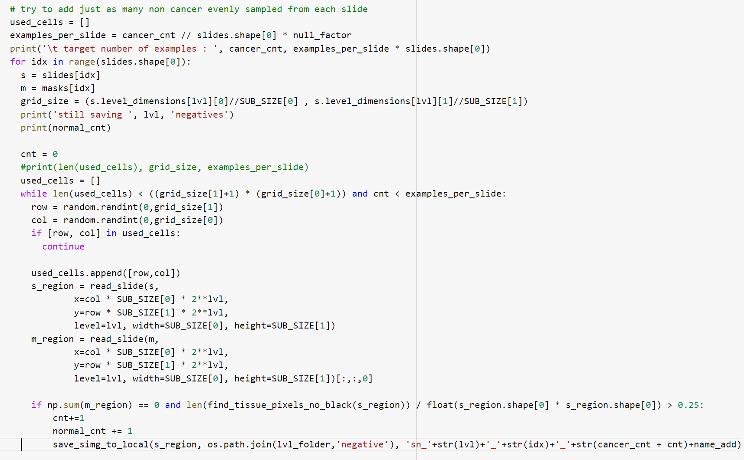
…

Slide 35
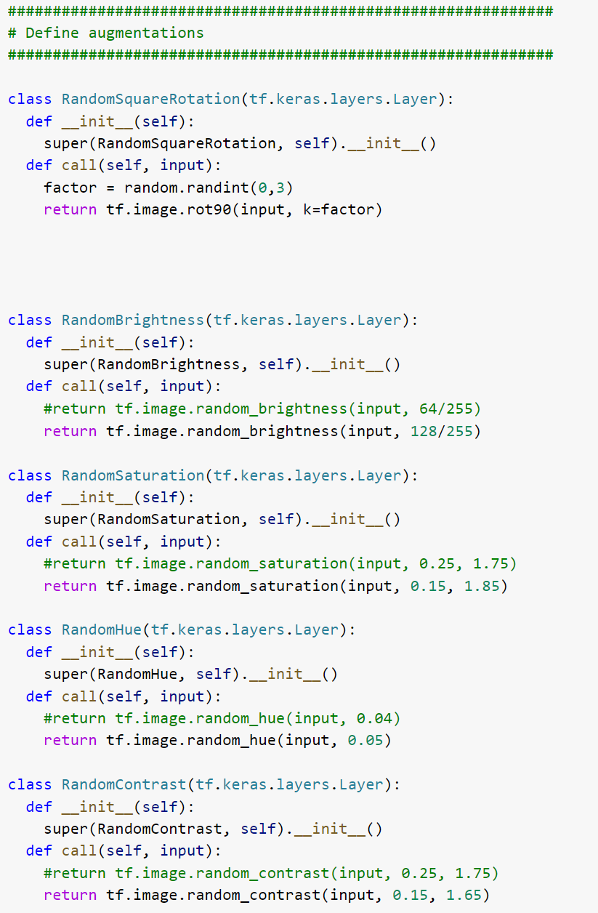
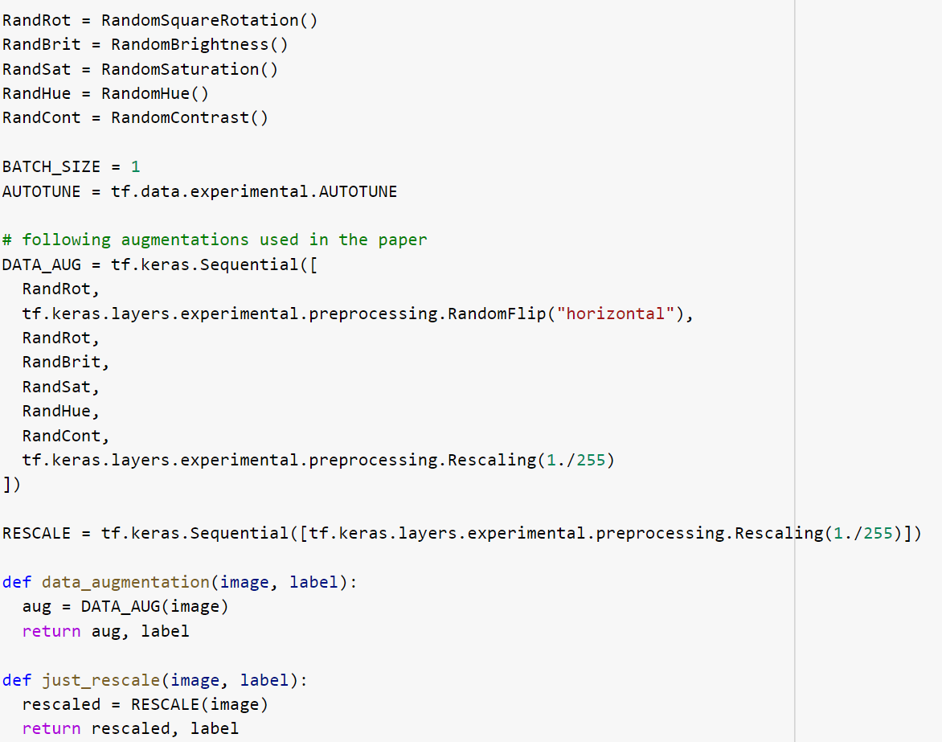

Slide 36
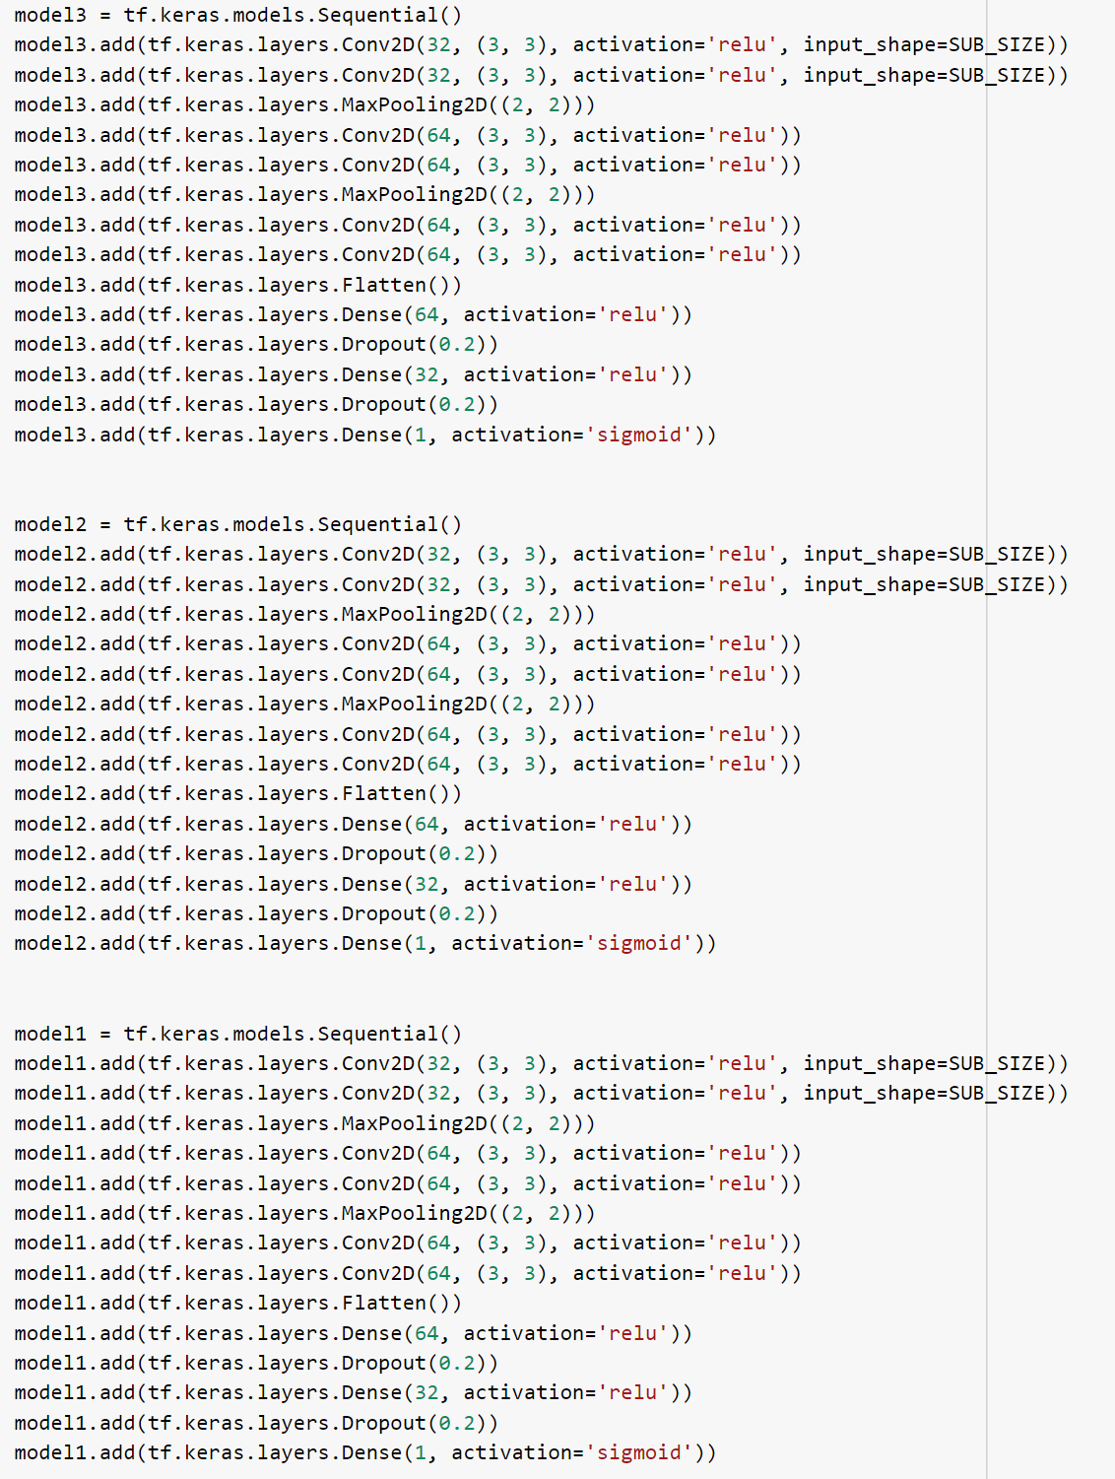


Slide 37


Slide 38


Slide 39


Slide 40


Slide 41


Slide 42


Slide 43


Slide 44
References
https://www.tensorflow.org/tutorials/images/transfer_learning
https://www.tensorflow.org/tutorials/load_data/images
https://www.tensorflow.org/tutorials/images/segmentation
https://www.tensorflow.org/tutorials/images/cnn
https://arxiv.org/abs/1505.04597
https://arxiv.org/abs/1703.02442

Slide 45
Thanks!

